Slide 1
Foreign Object Detection through a CNN Image Classifier
By
Juan Yostly

Slide 2
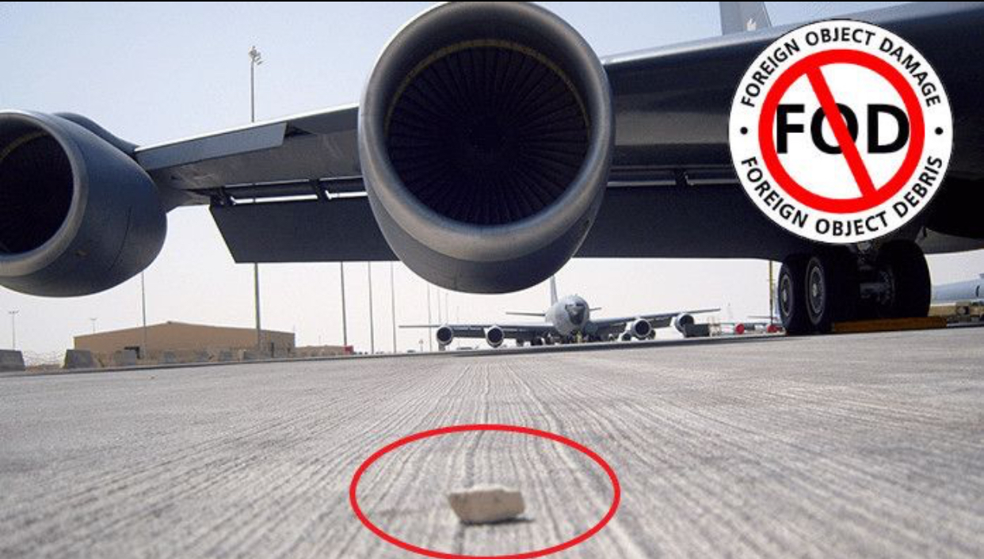
Notes:
Foreign object debris, known as FOD, is an ever increasing concern in the aerospace industry.
Causing nearly $13 billion in direct and indirect costs in the last year, the damage done by FOD presents a danger to the aircraft and the people exposed to the risk.
FOD includes debris, animals, or any other foreign substance in an operating environment that could cause substantial damage.
Many measures have been previously deployed to protect against FOD such as sweeping, magnetic bars, and detection cameras.
Proposed detection methods include video-based detection from cameras mounted on the edge of the runway, millimeter-wave radar, and convolutional neural network object detection models.

Slide 3
The Problem
FOD creates safety hazards and can ultimately impact safe operations by damaging aircraft.

Slide 4
The Solution
Train a portable object detector model for detecting FOD to decrease safety risks.
Notes:
My proposed solution is to use object detection models with proprietary cameras to develop a real time processing solution to observe FOD on the runway, maintenance areas, and storage hangars.

Slide 5
Data Wrangling

Slide 6
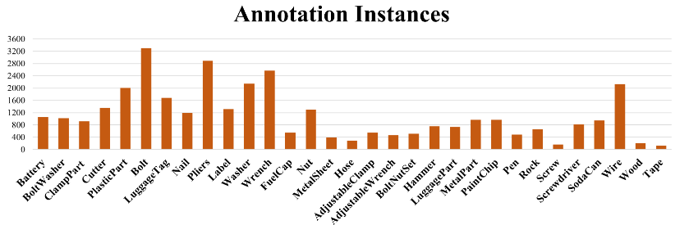
Data Source: https://github.com/FOD-UNOmaha/FOD-data
Notes:
Original Dataset has over 33000 images in 151 categories
Modifed data has 25835 images in 30 categories
Images were originally taken has a video and spliced into frames for data collection.

Slide 7
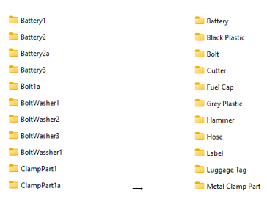
Modify Labels
Notes:
The dataset needed to be modified to fit the data object TensorFlow needed for preprocessing. The folder structure needed to be flattened to only one layer instead of the multiple subdirectories present within the structure. This means that the categories needed to be combined for general classification. This works well in our favor as this means different types of each object can be generalized combating overfitting.

Slide 8
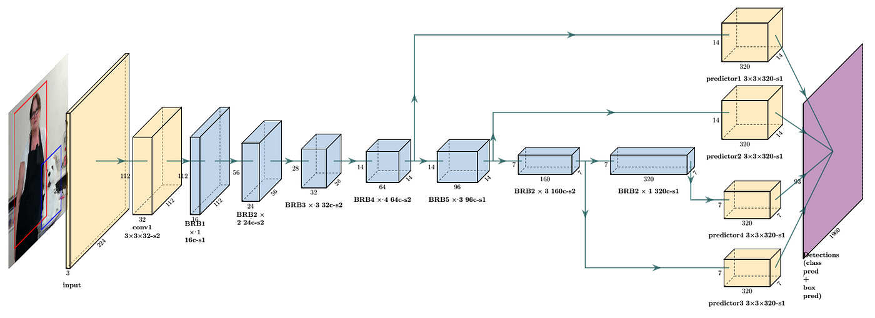
Pre-Trained Model Selection
Base model needs to be
- Portable
- Designed for CV
- Open Exchange Capable
MobileNet!
Also handles 400x400 images by conversion.
Notes:
There are many types of computer vision models to try out. Mobilenet stands out because of its intended purpose as a portable, lightweight CV model designed for IoT usage.

Slide 9
Preprocessing

Slide 10
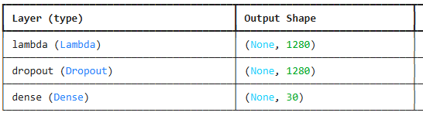
Parameters
Hyperparameters
Batch Size is 32
Number of Epochs is 10
Training/Validation split is 80/20
Add layers to modify the images in random ways i.e., rotation, translation, and zooms
Initial learning rate is 0.001 (fast)
Loss is computed as a crossentropy loss between labels and predictions
Callbacks can be used to speed up learning

Slide 11
Initial Model

Slide 12
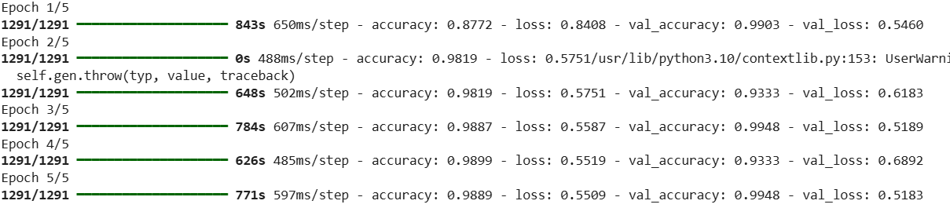

Slide 13
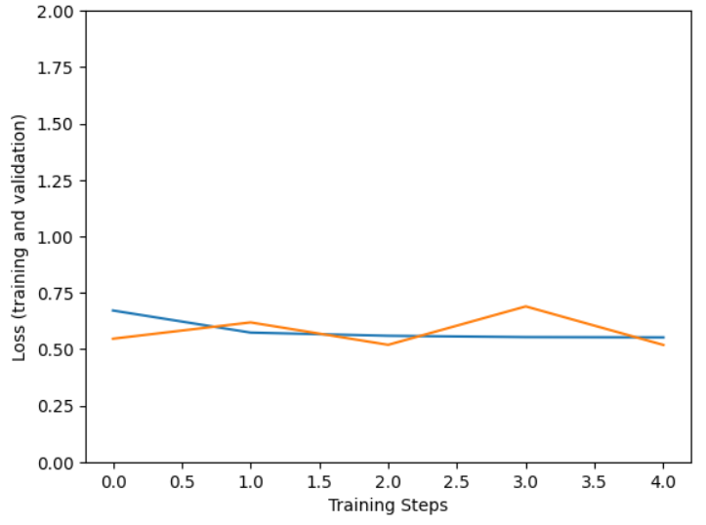
Loss
Actual vs Predicted
Notes:
When tuning my parameters, I used Grid Search Cross Validation

Slide 14
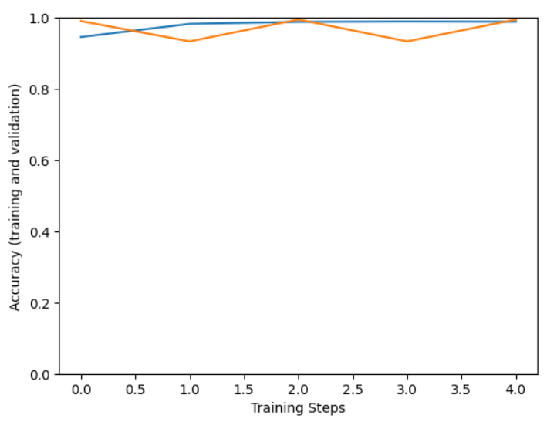
Accuracy
Actual vs Predicted
Notes:
When tuning my parameters, I used Grid Search Cross Validation

Slide 15
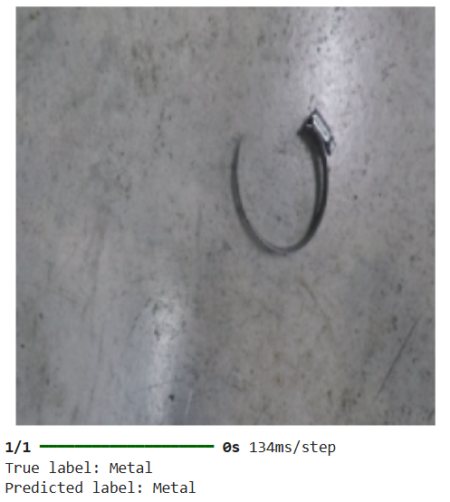

Slide 16
Updated Model

Slide 17
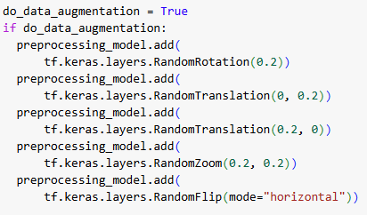

Slide 18
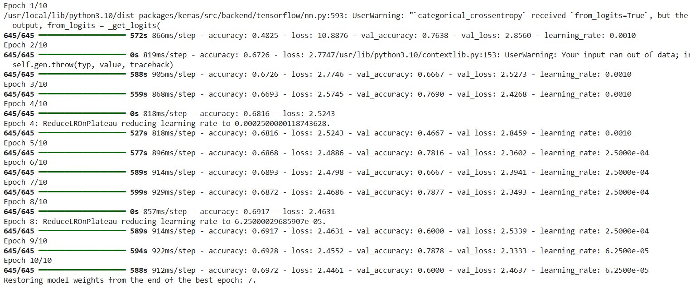

Slide 19
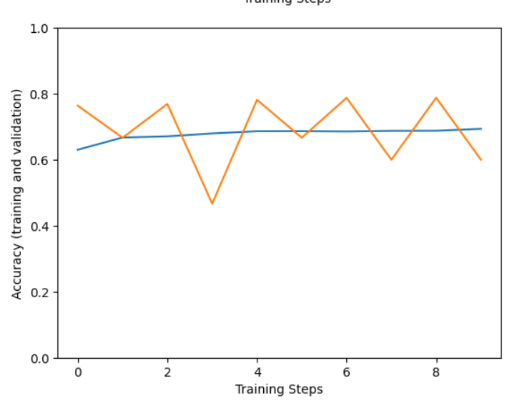

Slide 20
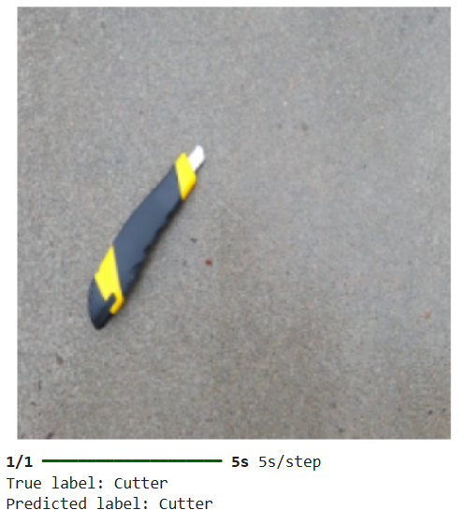

Slide 21
Takeaways
Updated model has a loss score of 2.34 and an accuracy score of 69.72% after seven epochs.
More training time is required for improving scores.
A portable, computer vision model has been constructed based off the MobileNet framework.
Nuts, bolts, and other small pieces of hardware were the hardest to detect due to their small size and characteristics.

Slide 22
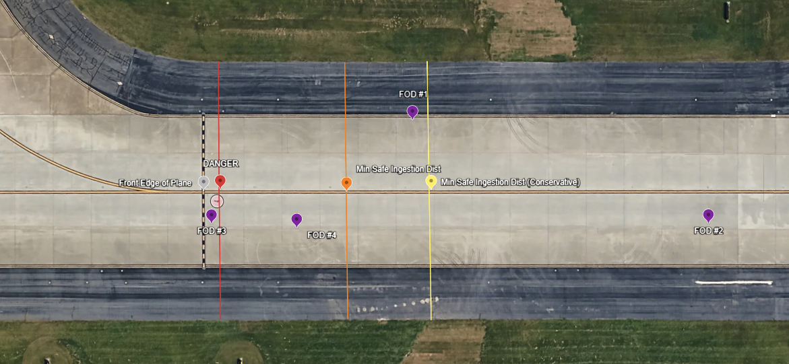

Slide 23
Future Research
More training (90% accuracy goal)
Expand to video
Real time calculations based on the scenario given
Integrate physical connectivity

Slide 24
Questions?

